Slide 1
JAVA PROJECT BATCH
GUI Programming
Lecture 6

Slide 2
Table Of Contents
01.
Using JLabel
02.
Property Opaque
03.
Using JTextField
04.
Methods Of JTextField
05.
Controls for making choices

Slide 3


Using JLabel
The “Jlabel” Class:
The JLabel component in swing is used to display text to the user. This text is read only that is the user cannot change it at run time.
Properties of “JLabel” class:
text: For setting the text on JLabel.
icon: For setting image on JLabel.
font: For changing font of the JLabel.
foreground: For changing the font color of JLabel.
opaque: For making the JLabel opaque so that background color gets applied.
background: For changing the background color of JLabel.

Slide 4
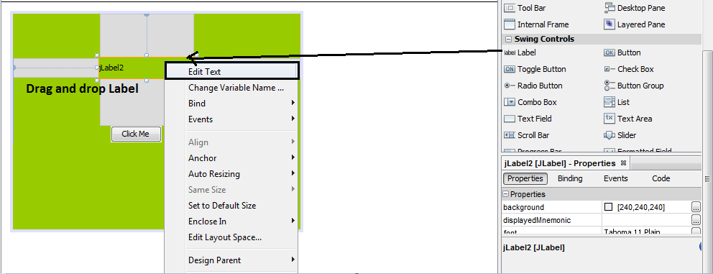
Property Opaque
Property Opaque:
In the Palette, select the Label component and drag it to the Jframe.

Slide 5
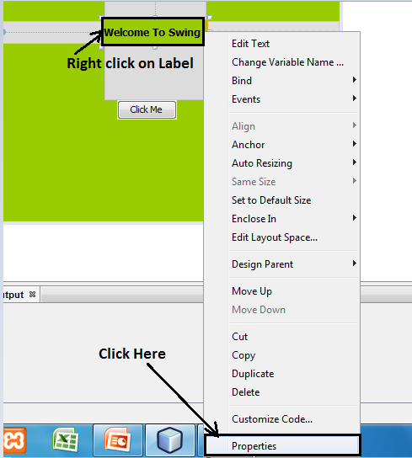
Property Opaque
2. Then select the JLabel make a right click and go to the Properties window on the bottom right corner.

Slide 6
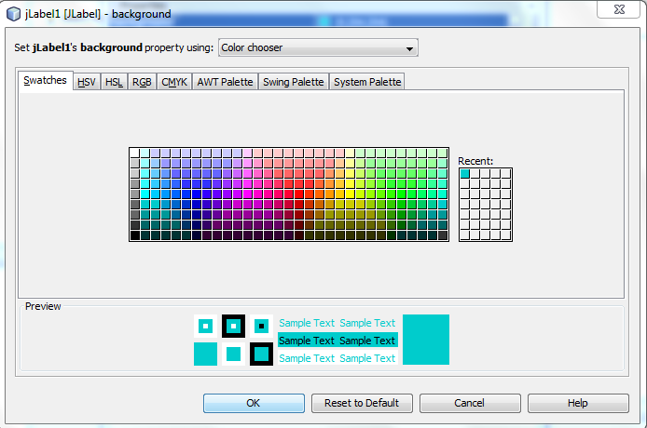
Property Opaque
3. There you will see Background property then choose the desired color. But you will notice that the background color of JLabel doesn't change.

Slide 7
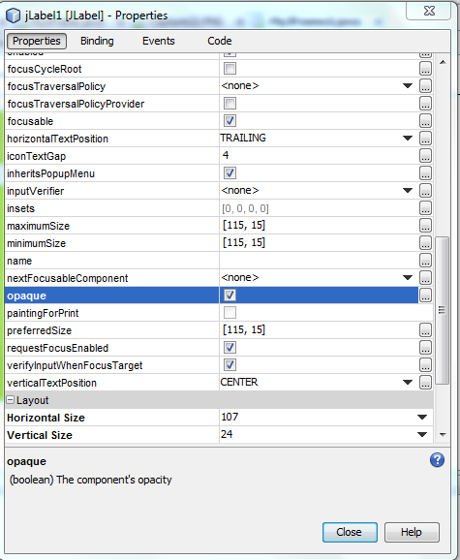
Property Opaque
4. Now keeping the JLabel selected, go to the properties window scroll down and see for the opaque property and then check the checkbox. Now you will be able to see the change in the background color of JLabel.

Slide 8
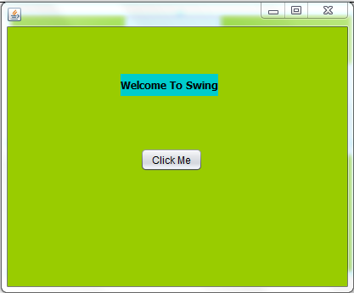
Property Opaque
Here is the output:
Methods of “JLabel” class:
1. public Icon getIcon()
2. public void setIcon(Icon)
3. public void setText(String)
4.public String getText()

Slide 9
JTextField
The “JTextField” class:
In GUI TextFields or TextBoxes are components used for taking input from the user. They are rectangular components displayed on our Frame or Panel and allow the
user to input/type some text. In swing , java povides us a class called JTextField for this.
Properties of JTextField:
text: For setting the text on JTextField.
editable: For making JTextField editable/uneditable.
font: For changing font of JTextField.
foreground: For changing the font color of JTextField.
background: For changing the background color of JTextField.

Slide 10
Methods of JTextField
Methods of JTextField
Methods of JTextField:
1.public String getText( )
2.public void setText(String)
3.public void setEditable(boolean)
4. public void setFont(Font)

Slide 11
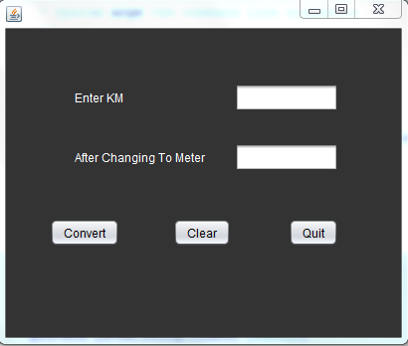
Example
Develop a swing based GUI application which accepts km from user and provide three button with the following behavior:
Convert: This button should convert km into m and display the result in second TextField.
2. Clear: Should erase contents of the all Textfields and bring focus to the first one.
3. Quit: Should terminate the application.

Slide 12
Example
private void jButton3ActionPerformed(java.awt.event.ActionEvent evt) {
System.exit(0); // For Quit Button
}
private void jButton2ActionPerformed(java.awt.event.ActionEvent evt) {
txtKm.setText("");
txtMeter.setText(""); // For Clear Button
txtKm.requestFocus();
}

Slide 13
Example
private void jButton1ActionPerformed(java.awt.event.ActionEvent evt) {
String km=txtKm.getText();
int kmnum=Integer.parseInt(km);
int mtr=kmnum*1000; // For Convert Button
txtMeter.setText(String.valueOf(mtr));
}

Slide 14
JOptionPane
The "JOptionPane" class:
1. Message Dialog
2. Confirm Dialog
3. Input Dialog
Generating "MessageDialog" :
1. public static void showMessageDialog(Component,Object)
2. public static void showMessageDialog(Component,Object,String,int)
3. public static void showMessageDialog(Component,Object,String,int,Icon)

Slide 15
JOptionPane
The "int" argument represents the predefined icons we want to use on Dialog Box and java has provided following options for this:
1. JOptionPane.ERROR_MESSAGE
2. JOptionPane.QUESTION_MESSAGE
3. JOptionPane.INFORMATION_MESSAGE
4. JOptionPane.PLAIN_MESSAGE
The Code:
JOptionPane.showMessageDialog(null,"Please input digits only!","Error!",JOptionPane.ERROR_MESSAGE);

Slide 16
Modified version of Convert Button Code
private void jButton1ActionPerformed(java.awt.event.ActionEvent evt)
{
String km=txtKm.getText();
try
{
int kmnum=Integer.parseInt(km);
int mtr=kmnum*1000;
txtMeter.setText(String.valueOf(mtr));
}

Slide 17
Modified version of Convert Button Code
catch(NumberFormatException e)
{
JOptionPane.showMessageDialog(null,"Please input digits only!","Error Occurred",JOptionPane.ERROR_MESSAGE);
}
}

Slide 18
Using Confirm Dialog
Confirm Dialog is mainly used for users choice before taking a particular action. To generate a
confirm dialog java provides us a method called showConfirmDialog() having three overloaded
versions:
Generating "ConfirmDialog" :
1. public static int showConfirmDialog(Component,Object)
2. public static int showConfirmDialog(Component,Object,String,int)
3. public static int showConfirmDialog(Component,Object,String,int,int);
4. public static int showConfirmDialog(Component,Object,String,int,int,Icon);

Slide 19
The Modified Code For “Quit” Button
private void jButton3ActionPerformed(java.awt.event.ActionEvent evt) {
int ans;
ans=JOptionPane.showConfirmDialog(null,"Are u sure?","Quitting!",JOptionPane.YES_NO_OPTION,JOptionPane.QUESTION_MESSAGE);
if(ans==JOptionPane.YES_OPTION)
System.exit(0);
}

Slide 20
Using Input Dialog
Input dialogs are used in those cases where we want to accept some input
also from the user at runtime. To generate an input dialog java provides us a method called showInputDialog belonging to the class JOptionPane. This
method has same argument as message dialog but its return type is string.
Generating "InputDialog" :
1. public static String showInputDialog(Object)
2. public static String showInputDialog(Component,Object)
3. public static String showInputDialog(Component,Object,String,int,Icon)

Slide 21
The Modified Code For “Quit” Button
private void jButton3ActionPerformed(java.awt.event.ActionEvent evt) {
int ans;
ans=JOptionPane.showConfirmDialog(null,"Are u sure?","Quitting!",JOptionPane.YES_NO_OPTION,JOptionPane.QUESTION_MESSAGE);

Slide 22
The Modified Code For “Quit” Button
if(ans==JOptionPane.YES_OPTION)
{
String name=JOptionPane.showInputDialog(null,"What is your Name?");
JOptionPane.showConfirmDialog(null,"Thank You " +name+ " for using this app");
System.exit(0);
}
}

Slide 23
Controls For Making Choices
In a GUI Application it is very common for a programmer to ask the user to provide his choice amongs an available list of choices.
For ex. :-
We might want to offer the user choice of selecting his gender or
hobbies and in such cases rather than using a text field java advices us to
use choice control. There are 4 choice control given by java calles as:
JCheckBox
JRadioButton
JComboBox
Jlist

Slide 24
JCheckbox
Checkboxes are toggle buttons and are mainly use to allow the user to
select more than one option amongs the available list of choices. Following are important properties of a JCheckbox:
text: For setting the text on checkbox.
icon: For setting image on checkbox.
selected: A boolean property for deciding the initial state of checkbox.
font: For changing font of the checkbox.
background: For changing the background color of checkbox.
foreground: For changing the font color of checkbox.

Slide 25
Handling JCheckBox Event
Events Fired In JCheckBox:
Whenever the user selects or de-selects a JCheckBox object , Java executes the
"ItemEvent" and calls the method "itemStateChanged( )" which is available in the
interface "ItemListener".
Obtaining State Of a JCheckBox:
To determine whether a JCheckBox object is currently selected or not we call the
method isSelected( ) of "JCheckBox" class. The prototype of the method is:
public boolean isSelected( )

Slide 26
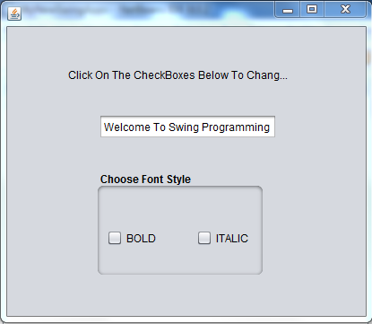
Example
Develop an application containing a text field and two checkboxes titled
bold and Italic. As the user selects or deselects these checkboxes apply
the required effect on the text in text field.

Slide 27
Example
private void chkBoldItemStateChanged(java.awt.event.ItemEvent evt) {
changeStyle();
}
private void chkItalicItemStateChanged(java.awt.event.ItemEvent evt) {
changeStyle();
}

Slide 28
Example
private void changeStyle() {
int fontstyle= Font.PLAIN;
if(chkBold.isSelected())
fontstyle+=Font.BOLD;
if(chkItalic.isSelected())
fontstyle+=Font.ITALIC;
Font f=new Font("Tahoma",fontstyle,11);
jTextField1.setFont(f);
}

Slide 29


